Slide 1

Tractor tek
Back up solution for TractorTek in case of database fail
Presented by: Tiania Chan
Wednesday, April 13, 2021

Slide 2

Introduction
Data Analyst – Tiania Chan, TekSystems Data Analytics Bootcamp
Problem: Sales Tracking System crashed leaving only back up data and needed a dashboard to visualize data
Solution: Create a database to complement the web app using SQLAlchemy and SQL Server to rebuild and repopulate the server with back up data
Analysis: Create a live connection to SQL Server to download data to an excel file and populate a dashboard displaying analysis of data from the last two years

Slide 3
Table of Contents
App Walkthrough:
Web App
Excel Dashboard
Analysis
EER Diagram
Loading of data to database by SQLAlchemy
Conclusion
Next Steps

Slide 4
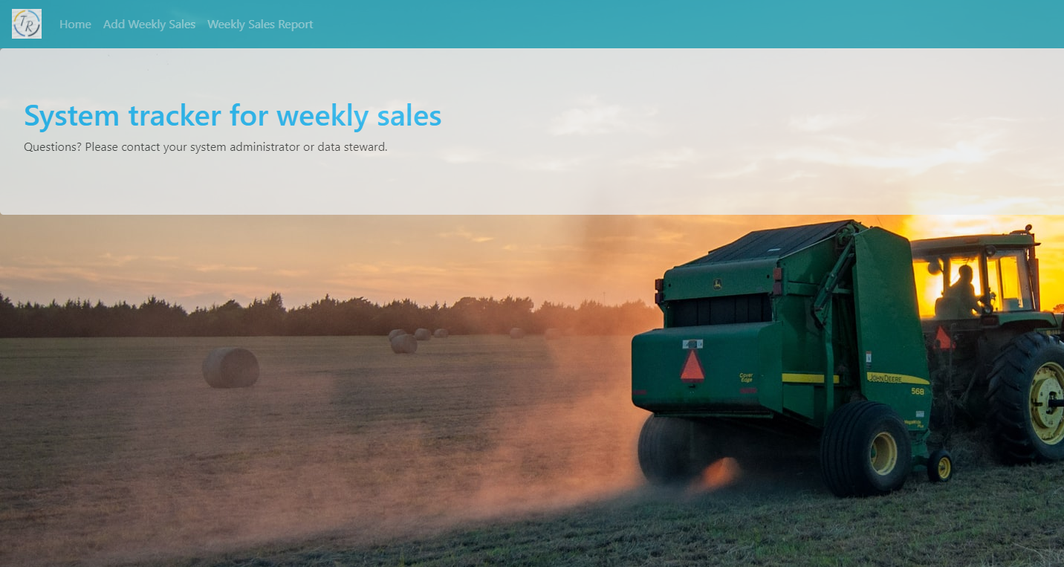
TractorTek Database Web App

Slide 5
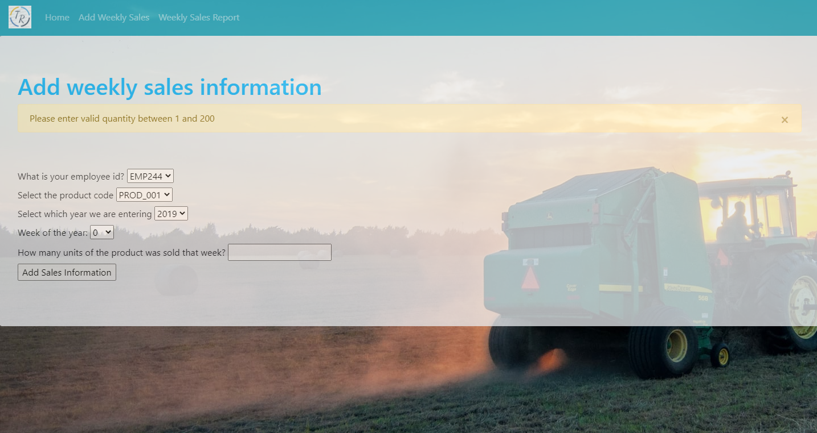
TractorTek Database Web App

Slide 6
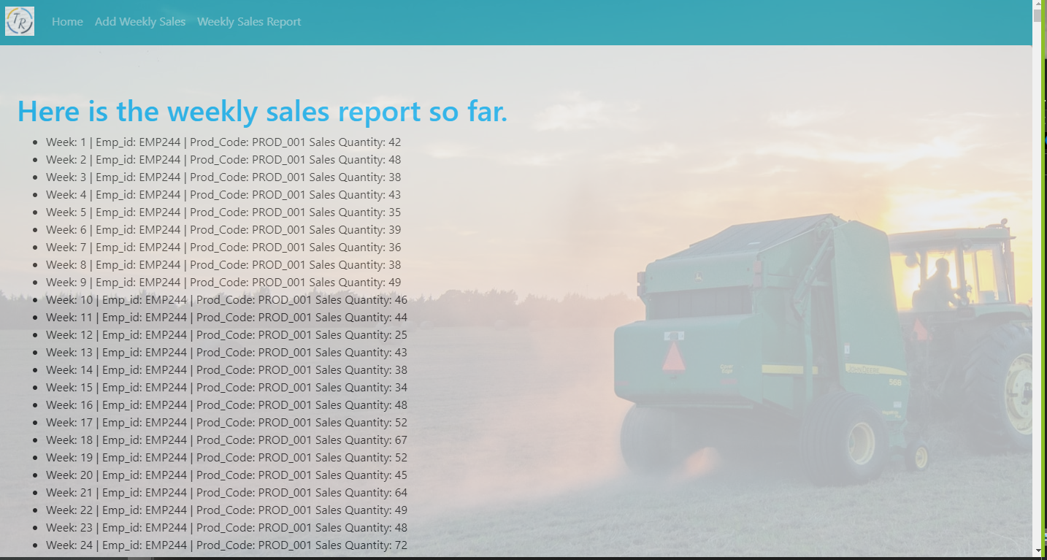
TractorTek Database Web App

Slide 7
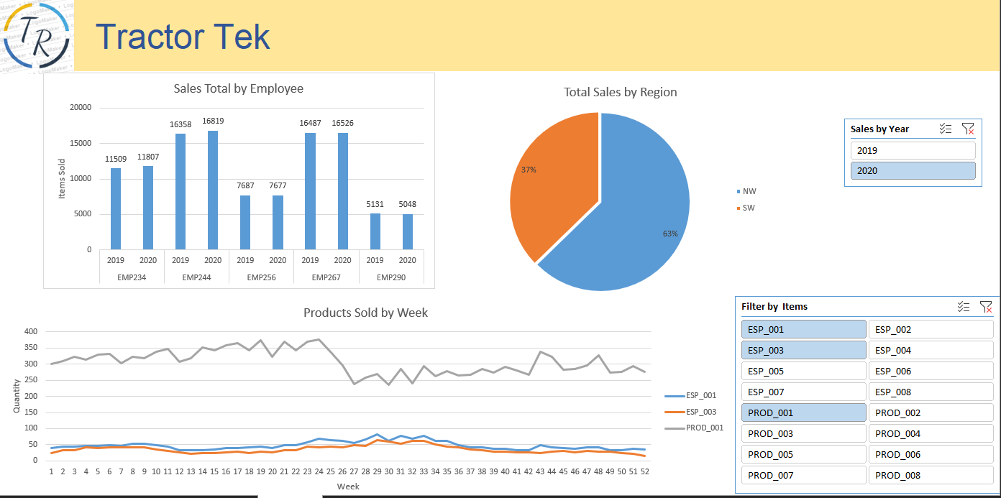
TractorTek Database Dashboard

Slide 8
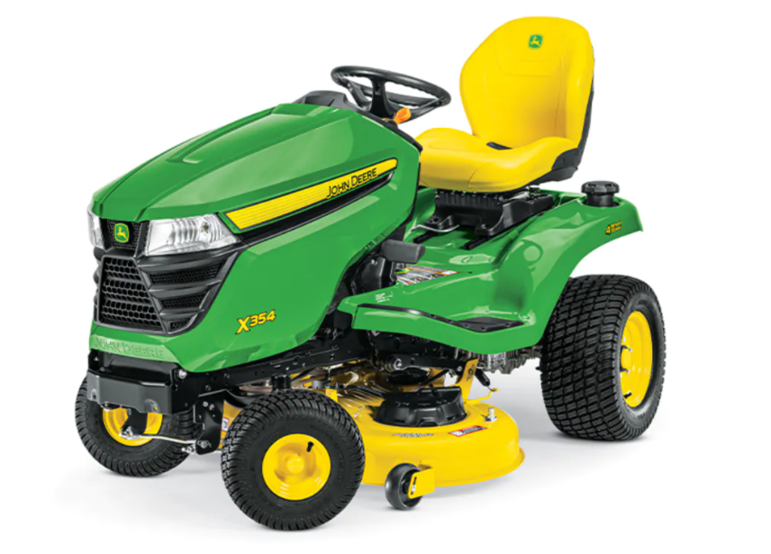
Analysis
Best Selling Products: They are Product 1 and the corresponding warranty
North West region does better than South West: This can be due to the amount of team members but needs further analysis for factors such as market demand in the area and overtime
Top Performers: Beverly and Gina are our top two performers so my recommendation is to speak with Beverly and Gina as well as Maude, our lowest performer to find areas of growth and train on the successes.

Slide 9
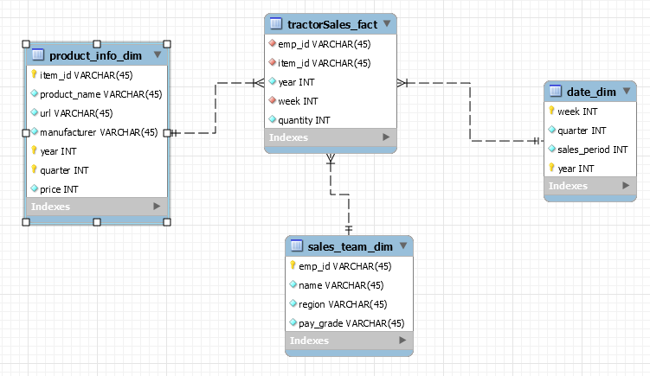
TractorTek Database EER Diagram

Slide 10
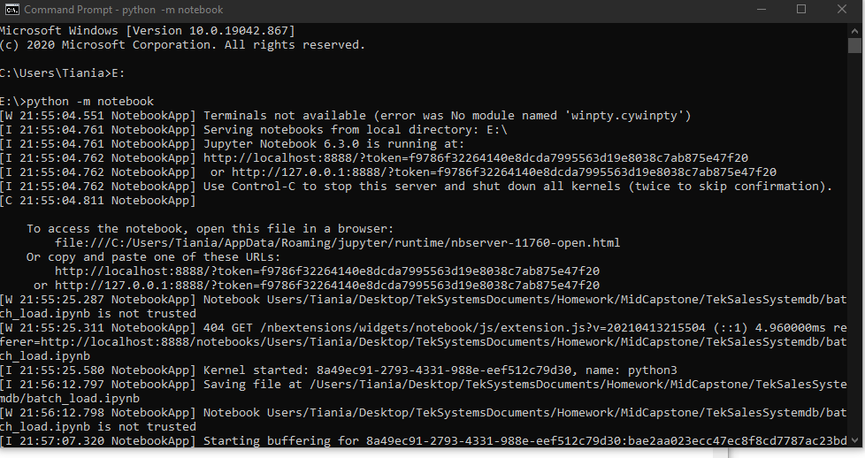
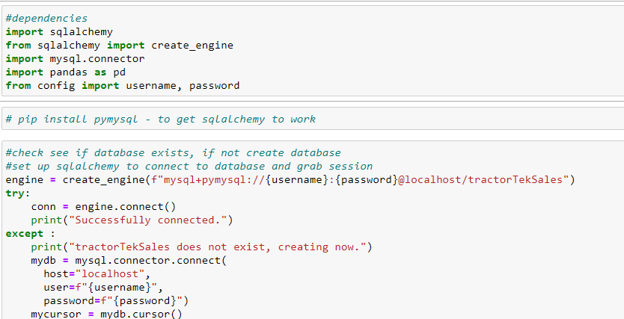
TractorTek Database SQLAlchemy
Let’s launch Jupyter Notebook

Slide 11
Conclusion
Problem: Sales Tracking System crashed leaving only back up data and needed a dashboard to visualize data
Solution: Create a database to complement the web UI using SQLAlchemy and SQL Server to rebuild and repopulate the server with back up data
Analysis: Create a live connection to SQL Server to download data to an excel file and populate a dashboard displaying analysis of data from the last two years
Value: Should the database crash again, Jupyter Notebook can be quickly launched with the back up data to create the database and tables. The dashboard is easy to use with slicers and will be automatically updated with any changes to the database

Slide 12
Next Steps
Expand Functionality of Web App:
Sales Tracking System currently inputs the data into the fact table but triggers are not yet written in the database to update once the fact table updates
Edit, Delete, and Add to the database via webapp
Error Checking: More error checking can be done for the Flask fields to increase functionality

Slide 13
Questions?

